Slide 1
CS: XXXX:XXXX
MEM (code + data)
BUS
CLK
CPU + register (control + Full addition)
PC: YYYY:YYYY
DI
DO
MEM
clock
Disk (code + data)
BIOS

Slide 2
Java
C / Asm
Shell (for users)
JDK
JVM
OS
Kernel (CPU scheduler, process control, memory, disk…)
Hardware (CPU, MEM, …)

Slide 3
Business
Application
OOA / OOD -> Design Patterns
Database
Network
Image Processing
OOP
C / Asm
Java
Procedure
Shell script
API
Shell (for users)
C / Asm
JDK
JVM
OS (C)
OS
Kernel (CPU scheduler, process control, memory, disk…)
Driver
Machine code, ASM
Hardware (CPU, MEM, …)
Firmware (FPGA)
Hardware (physics, materials)

Slide 4


test.c: #include <stdio.h>
c compiler:
gcc test.c –o test.bin
stdio.h
stdio.c
c compiler:
gcc –S x.c
*.asm
c compiler:
gcc x.c –o stdio.a (library)
Asm compiler
Binary
Kernel (CPU scheduler, process control, memory, disk…)
Hardware (CPU, MEM, …)

Slide 5
*.cpp
test.c: #include <stdio.h>
g++ test.cpp –o test.o
stdio.h
*.h
*.c
Impl class in *.c
*.asm
Binary
Kernel (CPU scheduler, process control, memory, disk…)
Hardware (CPU, MEM, …)

Slide 6
1, compile: check test.cpp (#include <stdio.h>) => test.o
2, link: stdio.a to test.o
3, build test.bin (stdio.a + test.o)
Test01.o
Test02.o
Test.bin
test.o
Stdio.a
tcp.so
.so files are dynamic libraries. The suffix stands for "shared object", because all the applications that are linked with the library use the same file, rather than making a copy in the resulting executable.
.a files are static libraries. The suffix stands for "archive", because they're actually just an archive (made with the ar command -- a predecessor of tar that's now just used for making libraries) of the original .o object files.
.la files are text files used by the GNU "libtools" package to describe the files that make up the corresponding library. You can find more information about them in this question: What are libtool's .la file for?
test.cpp
Test.o
*.h
Linux
library
Test.bin
Hardware (CPU, MEM, …)

Slide 7
test.cpp
Test.o
test.cpp
Test.o
*.h
*.h
Linux
Windows
library
Test.bin
library
Test.bin
Hardware (CPU, MEM, …)
Hardware (CPU, MEM, …)
Test.java
Test.class
Test.java
Test.class
JDK
JDK
Java system library / package
Test.jar
Java system library / package
JRE
Test.jar
JRE
JVM
JVM
*.h
*.h
Linux
Windows
library
library
Hardware (CPU, MEM, …)
Hardware (CPU, MEM, …)

Slide 8
Java
System.out
Java
System.out
JDK
JDK
JRE
JVM
Windows
Linux
JVM
Kernel (CPU scheduler, process control, memory, disk…)
Kernel (CPU scheduler, process control, memory, disk…)
Hardware (CPU, MEM, …)
Hardware (CPU, MEM, …)

Slide 9

Bash Tutorial
#include <stdio.h>
Void main() {
for (;;) {
char *input = wait_user_input(stdin);
switch (char *) {
case ‘echo’:
printf(…);
break;
default:
break;
}
}
}
#include <stdio.h>
int main() {
printf("Hello World\n");
return 0;
}
echo “Hello World”
C
Shell commands
Shell
OS
*.h (API)
lib
lib
Kernel (CPU scheduler, process control, memory, disk…)
Hardware (CPU, MEM, …)
Hardware (CPU, MEM, …)

Slide 10
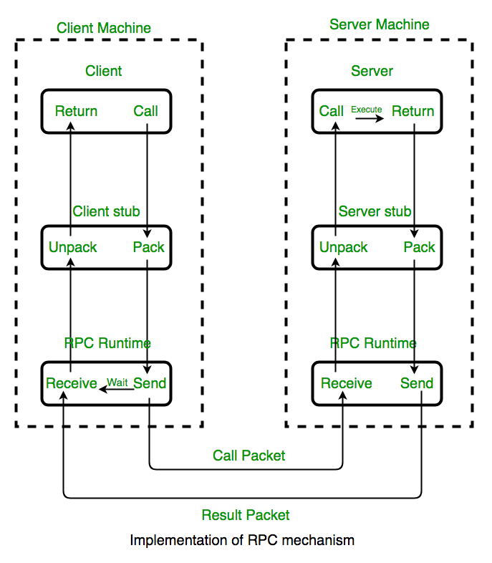
#include <weather.h>
#include <stdio.h>
char *w = getWeather(); print(w);
api stdio.h
api weather.h
User computer
Weather computer
RPC: Remote Procedure Call

Slide 11
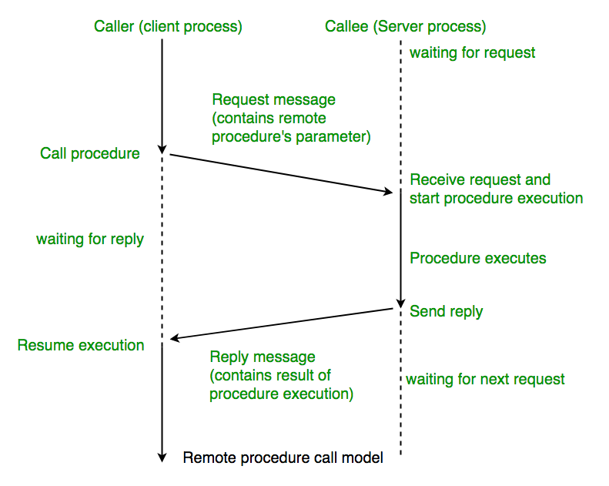

Slide 12

Program: getWeather, print
Program: getWeather, print
api stdio.h
api stdio.h
api weather.h
User computer
http get request
User computer
Weather computer
RPC: Remote P
REST api
Weather server
SL server

Slide 13

Linux
cd /
$ mount
/dev/sdd on / type ext4 (rw,relatime,discard,errors=remount-ro,data=ordered)
$ df –h
Filesystem Size Used Avail Use% Mounted on
/dev/sdd 1007G 1.7G 955G 1% /
$ mount | grep ewanbin
seliish01009.seli.gic.ericsson.se:/home010008/ewanbin on /home/ewanbin type nfs (rw,relatime,vers=3,rsize=65536,wsize=65536,namlen=255,hard,proto=tcp,timeo=600,retrans=2,sec=sys,mountaddr=150.132.5.94,mountvers=3,mountport=635,mountproto=udp,local_lock=none,addr=150.132.5.94)
$ df -h
Filesystem Size Used Avail Use% Mounted on
/dev/sda1 974M 300M 607M 34% /boot
127.0.0.1:/ 20G 9.8G 9.8G 50% /ctxmnt
seliish01009.seli.gic.ericsson.se:/home010008/ewanbin 20G 16G 4.6G 78% /home/ewanbin
/dev/sdb
/dev/sdd
sd disk
/dev/sda
/dev/sdc

Slide 14
Linux
cd /home/ewanbin
seliish01009.seli.gic.ericsson.se
/home010008/ewanbin
NFS
The Network File System (NFS) is a distributed file system protocol that allows users on a client computer to access files and directories located on a remote server as if they were stored locally. Essentially, it enables file sharing across a network, making it a valuable tool for collaboration and data sharing in environments with mixed operating systems.
$ mount | grep ewanbin
seliish01009.seli.gic.ericsson.se:/home010008/ewanbin on /home/ewanbin type nfs (rw,relatime,vers=3,rsize=65536,wsize=65536,namlen=255,hard,proto=tcp,timeo=600,retrans=2,sec=sys,mountaddr=150.132.5.94,mountvers=3,mountport=635,mountproto=udp,local_lock=none,addr=150.132.5.94)
$ df -h
Filesystem Size Used Avail Use% Mounted on
/dev/sda1 974M 300M 607M 34% /boot
127.0.0.1:/ 20G 9.8G 9.8G 50% /ctxmnt
seliish01009.seli.gic.ericsson.se:/home010008/ewanbin 20G 16G 4.6G 78% /home/ewanbin

Slide 15

Web server
View
Business
DB Prog
DB (data)
Web server
http requst
View
Business
DB Prog
Client computer
DB (data)

Slide 16
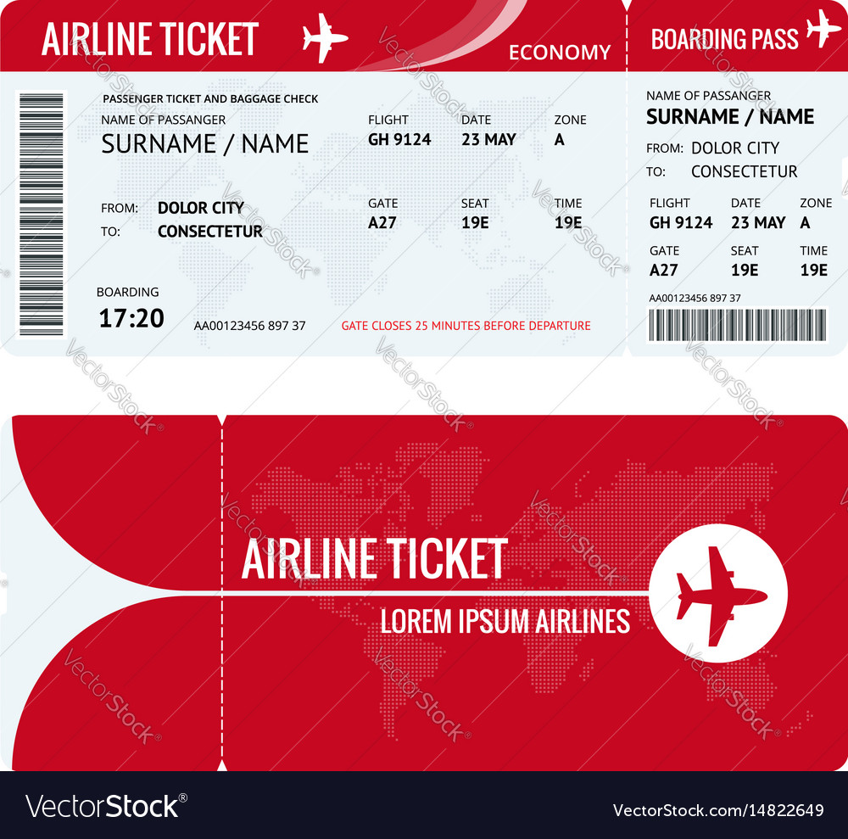
View
Business
DB (data)
Data cache reddis
Client computer
DB Prog
CDB (data)
DB (data)
Data cache reddis
Business
DB Prog
Client computer
http requst
Key: ?
reddis
DB (data)

Slide 17


View
Business
DB (data)
Data cache reddis
Client computer
DB Prog
DB (data)
Data cache reddis
Business
DB Prog
Client computer
http requst
Key: ?
reddis
DB (data)

Slide 18
View
Business
Client computer
DB Prog
DB (data)
Business
DB Prog
Client computer
http requst

Slide 19
View
Business
Client computer
DB Prog
DB (data)
Business
DB Prog
Client computer
http requst
Security Authentication
DB (data)
DB Prog

Slide 20

Active
standby
Active
standby
Active
Active
Access Mgm
VM scheduler
Access Mgm
VM scheduler
Access Mgm
VM scheduler
Access Mgm
VM scheduler
Storage Mgm
Storage Mgm
Storage Mgm
Storage Mgm
Network Mgm
Network Mgm
Network Mgm
Network Mgm
Dashboard
Dashboard
Dashboard
Dashboard
Virtualization Hypervisor
Virtualization Hypervisor
Virtualization Hypervisor
Virtualization Hypervisor
OS: Red Hat
OS: Red Hat
OS: Red Hat
OS: Red Hat
Hardware
Hardware
Hardware
Hardware

Slide 21
Access Mgm
Agent
Manager
Manager
VM scheduler
Agent
Access Mgm
Agent
Agent
Network Mgm
Storage Mgm
Storage Mgm
Dashboard
Network Mgm
VM scheduler
Network Mgm
Virtualization Hypervisor
Virtualization Hypervisor
Virtualization Hypervisor
Virtualization Hypervisor
OS: Red Hat
OS: Red Hat
OS: Red Hat
OS: Red Hat
Hardware
Hardware
Hardware
Hardware

Slide 22
voting
Access Mgm
Agent
VM scheduler
Agent
Access Mgm
Agent*
Agent*
Network Mgm
Storage Mgm
Storage Mgm
Dashboard
Network Mgm
VM scheduler
Network Mgm
Virtualization Hypervisor
Virtualization Hypervisor
Virtualization Hypervisor
Virtualization Hypervisor
OS: Red Hat
OS: Red Hat
OS: Red Hat
OS: Red Hat
Hardware
Hardware
Hardware
Hardware

Slide 23


MEM
CPU
REG A, B, C, D, CS, DS, SS, SP, …
SEG 01A3
SEG 01A4
MOV A, [0x01A3:0000]
MOV B, [0x01A3:0002]
01A3:0000 | 01
01A3:0001 | 00
01A3:0002 | 02
01A3:0003 | 00
01A3:0004 | 03
01A3:0005 | 00
ADD A, B
MOV, [0x01A3:0004], A
01A4:1000 | 01
01A4:1001 | 01
 | A3
 | 01
 | 00
 | 00
MOV A, [0x01A3:0001]
MOV B, [0x01A3:0003]
0x02
0x01
ADD A, B
MOV, [0x01A3:0005], A
FA
0x03

Slide 24







SCM: Software Configuration Management
Remote master
Git pull
Git pull
Local master
Git push
Git checkout –b test
commit
Git rebase
commit
Git commit
Local test
Git commit --amend
Docklin

Slide 25
SCM: Software Configuration Management
Remote master
Submit / merge
Git push
commit
commit
Gerrit patchset
Git pull
Git pull
Git commit
Git commit --amend
Local master
Docklin

Slide 26

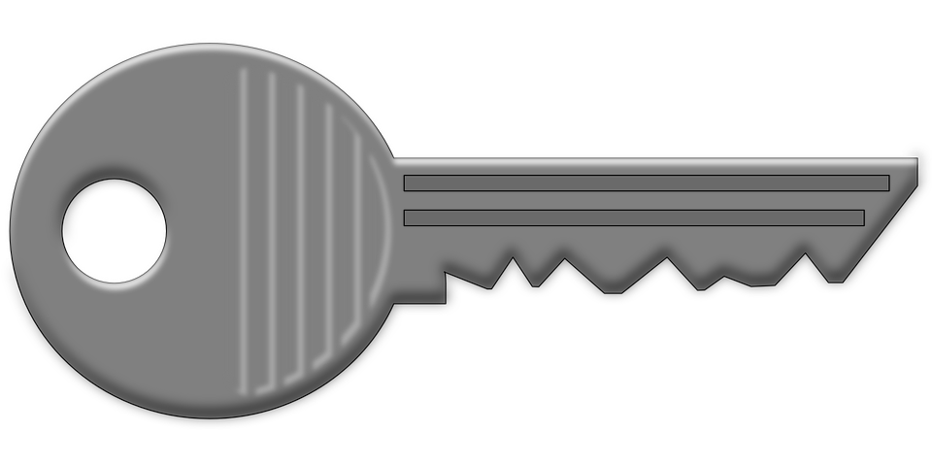

Github remote repository
3
cat ~/.ssh/id_ed25519.pub
Local repository
ssh-keygen -t ed25519 -C "mo.mosverkstad@gmail.com"
/home/ewanbin/.ssh/id_ed25519
/home/ewanbin/.ssh/id_ed25519.pub
1
2
eval "$(ssh-agent -s)"
ssh-add ~/.ssh/id_ed25519
4
ssh -T git@github.com
5
Change your Git remote URL to use SSH
git remote set-url origin git@github.com:mo-mosverkstad/SVG_Editor.git

Slide 27
Language:
Types: int (Integer), long (Long), float (Float), double (Double), char (Char), String, bool (Boolean)
Functions: operations (+, - *, /, …), java.util.*, java.math.*
Data structure: Array, List (ArrayList, HashList), HashMap, Set, … / algorithm
Oop
Design Patterns
class TestComputer {
bool testPowerOn(String password, ComputerIntf computerObj) {
return !(computerObj.powerOn(password) > 600);
}
}
class ComputerFactory {
ComputerIntf generateComputer(String type) {
if (“HP”.equals(type)) return new HpComputer();
if (“TP”.equals(type)) return new TpComputer();
return null;
}
}
class Test {
public static void main(String… args) {
TestComputer test = new TestComputer();
ComputerFactory factory = new ComputerFactory();
test.testPowerOn(args[0], factory.generateComputer(args[1]));
}
}
class HpComputer implements ComputerIntf {
int setHardware(String hardware) {
}
int powerOn(String password) {
…. Hardware…;
return startupTime;
}
}
class TpComputer implements ComputerIntf {
int powerOn(String password) {
….
return seconds;
}
}
interface ComputerIntf {
int powerOn(String);
}

Slide 28
CS
xxxx:9910
IP
xxxx:A003
CS
9910h
int main() {
printf(“hello, world!”);
}
A003h

Slide 29
Java
hpComputer01.powerOn()
class HpComputer
powerOn()
public static Boolean Hardware.isIntelCpu = True;
hpComputer02.powerOn()
class TpComputer
public static void Test.main() {
…
}
tpComuter.powerOn();
class TestComputer
class Test
class Hardware

Slide 30
class Test
public static void main(…) {
public static void Test.main() {
…
}

Slide 31
class HpComputer implements ComputerIntf {
int powerOn(String password) {
if (Hardware.isIntelCpu) …;
return startupTime;
}
}
class TpComputer implements ComputerIntf {
int powerOn(String password) {
….
return seconds;
}
}
interface ComputerIntf {
int powerOn(String);
}
class Test {
public static void main(String… args) {
if (Hardware.isIntelCpu) …
TestComputer test = new TestComputer();
ComputerFactory factory = new ComputerFactory();
test.testPowerOn(args[0], factory.generateComputer(args[1]));
}
}
class Hardware {
public static Boolean isIntelCpu = True;
}

Slide 32
intArray
Primitive array
0000
intArray[0]
int[] intArray = {0,0,0,0,0,0,0,0,0,0};
Or
int[] intArray = new int[10];
int...
0001
intArray[len-1]
 | Java
Primitive array | Supported
Improved array | ArrayList
List | LinedList

Slide 33
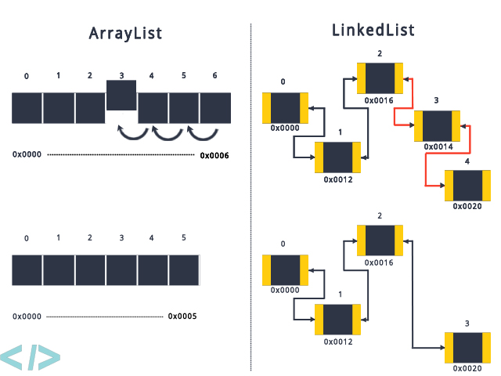

Slide 34
previous
List
head
0010
0010
next
0523
5
next 0A82
Append:
Node node = new Node();
node.tail = null;
tail.next = node;
0523
pointer
tail
0A82
Iterate:
pointer = head; // pointer=0010
while (pointer != null) {
pointer.value;
previous = pointer;
pointer = pointer.next; // pointer=0523
}
tail
1439
null
Delete:
If (pointer.next == null) {
previous.next=null;
} else {
previous.next = pointer.next;
}
Insert:
Node node = new Node();
Node.next = pointer.next
pointer.next = node;

Slide 35
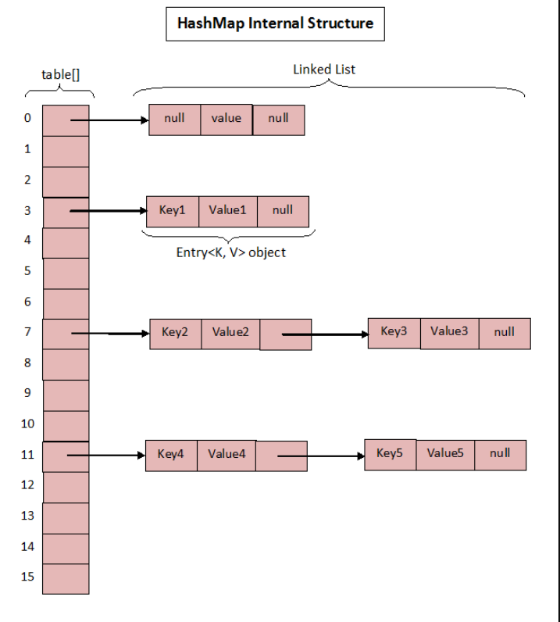
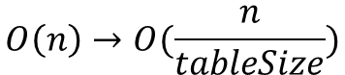
HashMap
Key=1, value=”Sanders”
Key=17, value=“Onur”
key=1,value=sanders (next)
key=17,value=onur (next=null)
Hash algorithm:
hashIndex = Key mod tableSize
hashIndex = 1 mod 16 = 1
hashIndex = 17 mod 16 = 1
Access time = Num/tableSize
$$O\left(n\right)→O(\frac{n}{tableSize})$$

Slide 36



Requirements
Customer
Study (what)
System designer
Product
Designer / Programmer
Tester

Slide 37
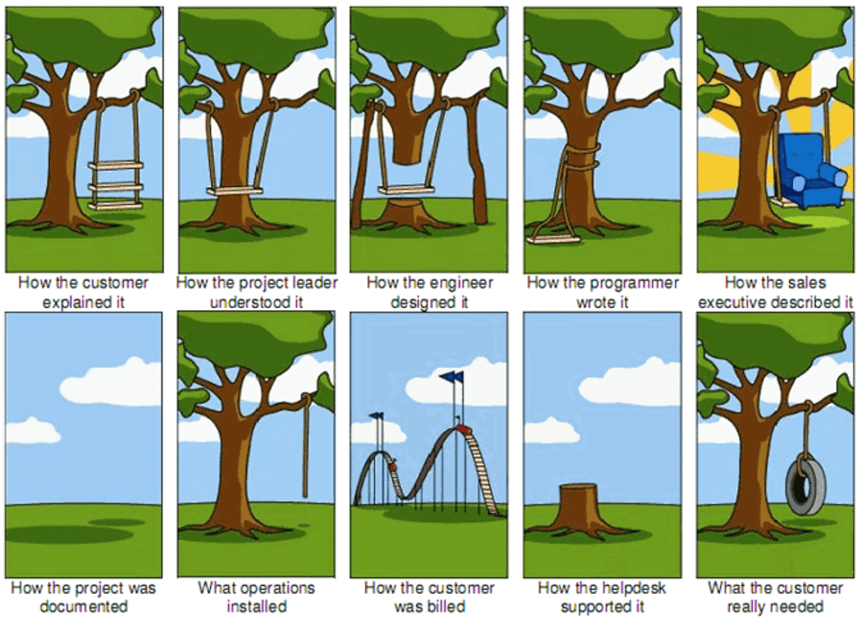

Slide 38


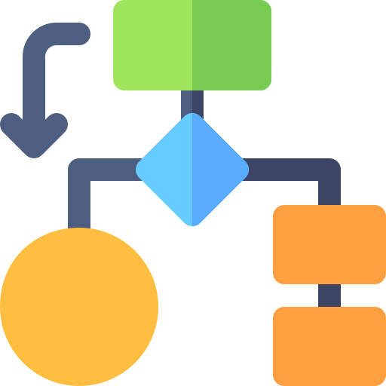

Requirements
Customer
Study (what)
System designer
Product
Designer / Programmer
Tester
Tester
Content (what)
Schedule (when)
Cost (how much)
Quality (how good)
Program Manager / Project Manager (PM)

Slide 39
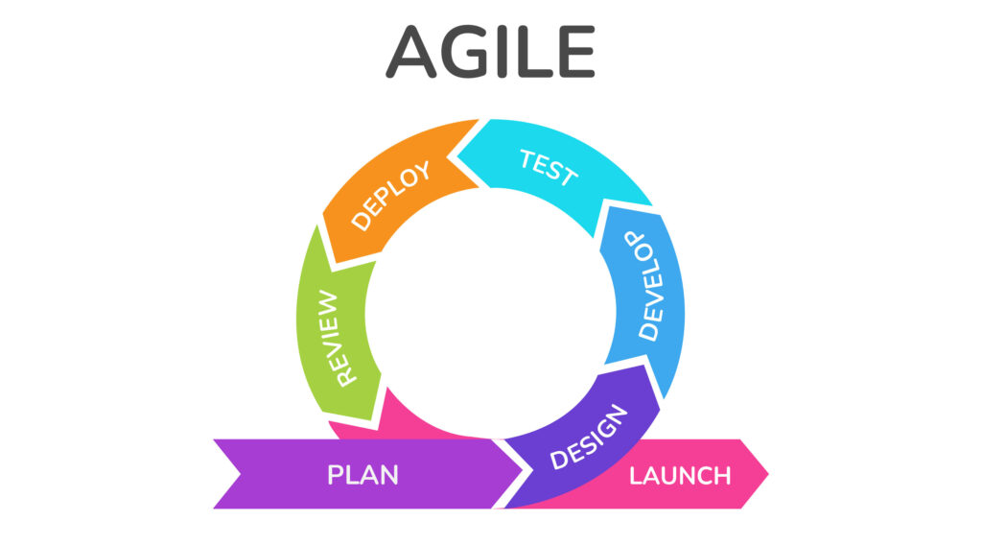
Program Manager / Project Manager (PM)

Slide 40

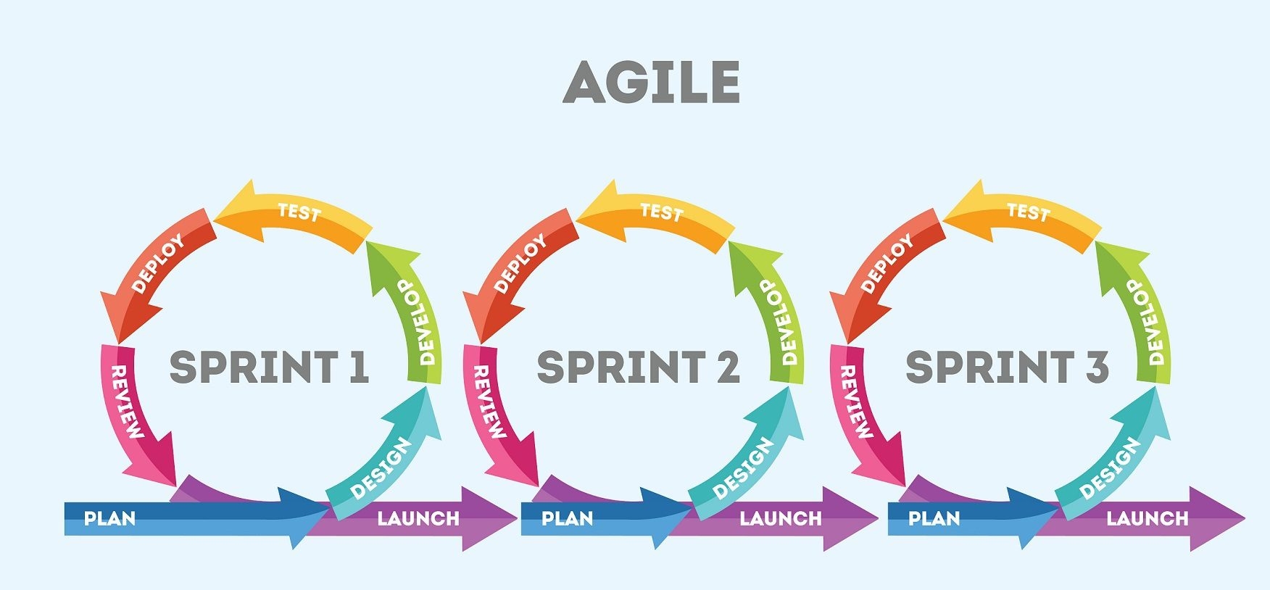



Slide 41
Adapter.print(“hello, world!”);
Class Adapter {
public static void print(args) {
if (isPresent(System)) {
System.out.println(args);
return;
}
if (sys.getVersion().equals(“0.1”)) {
sys.printf(args);
} else if (sys.getVersion().equals(“0.2”)) {
sys.print(args);
} else if (sys.getVersion().equals(“0.3”)) {
sys.println(args);
}
}
}
Version 0.1 sys.printf
Version 0.2 sys.print
Version 0.3 sys.println

Slide 42
Callback
Call return = userEvent(args)
Return userEvent(args)

Slide 43
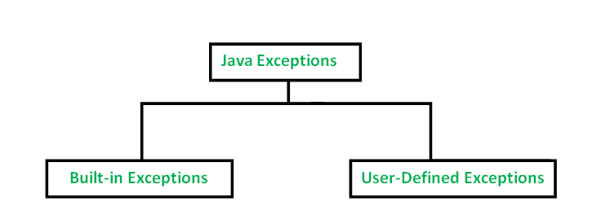
Exception
CS XXXX:XXXX

Slide 44
String toString() {
return “XXXX”;
}
Return value
Functio name ()
throw Exception
Function body

Slide 45




OOP
business
lambda?
enum, interface, record, …
C++ / Java
class
class
struct
C/CHILL/COBOL
erlang
Assembler
COMPILER
Machine code, binary code

Slide 46
typedef struct {
uint32 id,
char* name
} Person
Person alice;
8
8
8
8
typedef struct Person {
uint32 id,
char* name
}
typedef struct Police {
uint32 id,
char* name
uint32 police_id;
}
Police bob;
class Person {
uint32 id,
char* name
}
class Police::Person {
uint32 police_id;
}
Police bob;

Slide 47
List<Person> stuffs
Person alice:
Id, name, gender…
boolean isMale();
int getAge();
…
cache
cache
boolean isMale(char* id)

Slide 48
public static void main(String[] args) {
GreetingClass greeting = new GreetingClass();
greeting.greet("Java");
GreetingInterface greeting2 = new GreetingClass();
greeting2.greet("Java");
GreetingInterface greetingItaly = name -> {
System.out.println(String.format("Ciao, %s!", name));
return 0;
};
System.out.println(greetingItaly.greet("Java"));
}
int greetingItaly_greet (String name) {
System.out.println(String.format("Ciao, %s!", name));
return 0;
};
public interface GreetingInterface {
public int greet(String name);
}

Slide 49
public interface Predicate <T> {
boolean test(T t);
}
Predicate<Integer> isEven = i -> i % 2 == 0;
System.out.println(isEven.test(2));
public class MyPredicate <Integer> implements Predicate {
boolean test(Integer number) {
return number % 2 == 0;
}
}
MyPredict<Integer> predicator = new MyPredicate<>();
boolean return = Predicate.test(xxx);

Slide 50
Interface | Type
Runnable | →
BiConsumer(T, U) | T, U →
BiFunction(T, U, R) | T, U → R
BinaryOperator | T, T → R
BiPredicate<T, U> | T, U → boolean
BooleanSupplier | → boolean
Consumer | T →
DoubleBinaryOperator | double, double → double
DoubleConsumer | double →
DoubleFunction | double → R
DoublePredicate | double → boolean
DoubleSupplier | boolean →
DoubleToIntFunction | double → int
DoubleToLongFunction | double → long
DoubleUnaryOperator | double → double
Function<T, R> | T → R
IntBinaryOperator | int → int
IntConsumer | int →
IntFunction | int → R
IntPredicate | int → boolean
IntSupplier | → int
IntToDoubleFunction | int → double
IntToLongFunction | int → long
A list of all the functional interfaces in java

Slide 51
IntUnaryOperator | int → int
LongBinaryOperator | long, long → long
LongConsumer | long →
LongFunction | long → R
LongPredicate | long → boolean
LongSupplier | → long
LongToDoubleFunction | long → double
LongToIntFunction | long → int
LongUnaryOperator | long → long
ObjDoubleConsumer | T, double →
ObjIntConsumer | T, int →
ObjLongConsumer | T, long →
Predicate | T → boolean
Supplier | → T
ToDoubleBiFunction<T, U> | T, U → double
ToDoubleFunction | T → double
ToIntBiFunction<T, U> | T, U → int
ToIntFunction | T → int
ToLongBiFunction<T, U> | T, U → long
ToLongFunction | T → long
UnaryOperator | T → T

Slide 52

(element1=Harry, element2=Bob)
(element1=?, element2=Eve)
println(Harry)
println(Bob)
Harry
Bob
David
Eve
println(David)
(element1=?, element2=David)
forEach:
element -> System.out.println(element)
println(David)
println(Bob)
println(Harry)
cache
cache
sort:
(element1, element2) -> element1.compareTo(element2)
cache
cache

Slide 53
public interface Stream<T>
extends BaseStream<T,Stream<T>>
BaseStream<T,Stream<T>>
T
Next
T
Next
Stream<T>
Stream<T>

Slide 54
Harry
Bob
David
Eve
i
1
4
5
3
i
j
i
1
3
5
4
5
3
4
1
j
j
i
i
3
5
4
1
1
3
4
5
i
j
j
1
5
4
3
j

Slide 55
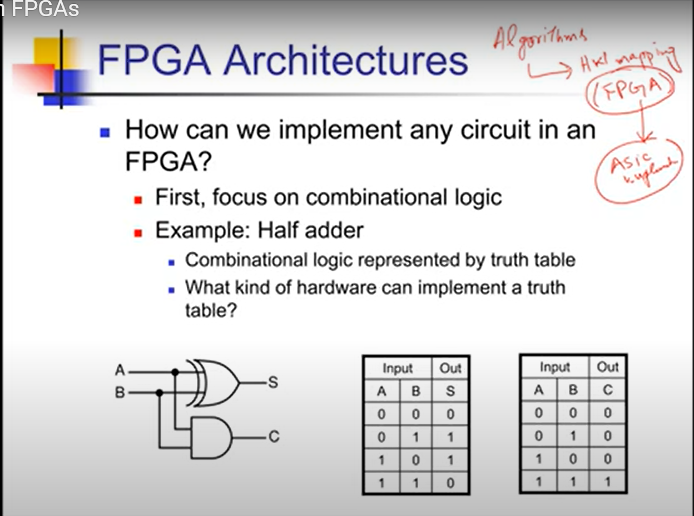

Slide 56
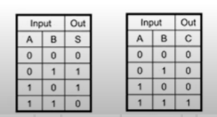
A
LUT
B
CLK
RST
LUT
LUT
0
0
1
MUX
D Flip-Flop
0
MUX
S
MUX
D Flip-Flop
1
MUX
C
0
0
1
CLK
A
CLK
A
RST
B
RST
B

Slide 57
A
CLB
B
S
CLK
C
RST
LUT
CLB
00
01
MUX
D Flip-Flop
MUX
S
01
C
10
A Configurable Logic Block (CLB) is the fundamental building block of an FPGA (Field-Programmable Gate Array). It's where the actual logic functions are implemented and configured. CLBs consist of smaller components like Look-Up Tables (LUTs), flip-flops, and multiplexers, allowing them to implement a wide range of logic functions.
CLK
A
RST
B

Slide 58
An FPGA LUT (Look-Up Table) is a fundamental building block for implementing logic in Field-Programmable Gate Arrays. It's essentially a small, configurable memory that stores the truth table of a Boolean function, allowing it to realize any combinational logic circuit with a limited number of inputs.
Here's a breakdown of the LUT structure:
1. Memory Unit (LUT):
The LUT itself is a small memory array (typically SRAM) that stores the truth table of the desired logic function.
The number of memory cells in the LUT corresponds to the number of possible input combinations. For example, a 4-input LUT has 16 memory cells (2^4), and a 6-input LUT has 64 (2^6).
Each memory cell holds a single bit, representing the output of the function for a specific set of input values.
2. Multiplexer (MUX):
A multiplexer (MUX) is used to select the appropriate output value from the LUT's memory based on the current input values.
The MUX's selection lines are connected to the LUT's input signals.
When the input signals change, the MUX selects the corresponding memory location and outputs its stored value.

Slide 59
How it works:
The input signals are applied to the address lines of the LUT's memory.
The memory unit outputs a value based on the input address.
The multiplexer selects this output and passes it to the LUT's output.
Example:
A 3-input LUT can implement any 3-input Boolean function.
To implement an AND gate, the LUT would store a truth table where the output is '1' only when all three inputs are '1'.
Applying the input values to the LUT would select the corresponding memory location, and the AND gate's output (either '0' or '1') would be available at the LUT's output.
Key Features:
Flexibility:
LUTs can implement any combinational logic function with a limited number of inputs.
Configurability:
The contents of the LUT's memory are programmed during FPGA configuration, allowing the same LUT to implement different functions at different times.
Scalability:
Modern FPGAs often use larger LUTs (e.g., 6-input LUTs) to implement more complex logic functions.

Slide 60
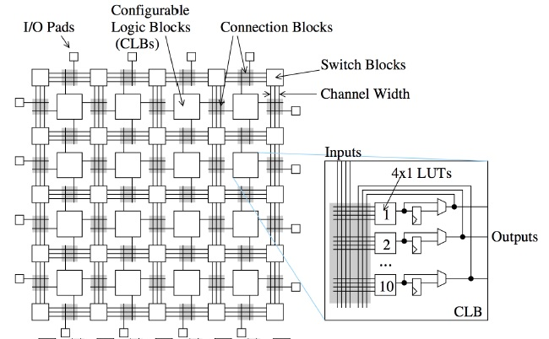
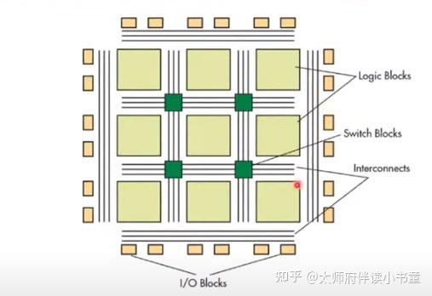


What you need to know about the internal structure of FPGA_VEMEKO
Structure of Field Programmable Gate Array (FPGA)
An FPGA, or Field Programmable Gate Array, is built around a grid of configurable logic blocks (CLBs) and specialized blocks like DSPs and RAM, connected by a programmable interconnect network. These components allow for flexible logic implementation and customization for specific applications.
https://hdlbits.01xz.net/wiki/Main_Page

Slide 61




DSP
FPGA (CLBs)
IO
DSP
FPGA (CLBs)
ARM CPU
Linux
IO
and_gate.cfg
and_gate.v
pmod_0 78
Pmod_1 77
IO
FPGA (CLBs)
IO
led_0 99

Slide 62
QBayLogic - CPU vs FPGA explained in a short animation
https://www.youtube.com/watch?v=BML1YHZpx2o
Look Up Tables in FPGAs
https://www.youtube.com/watch?v=C0SvoFFdJnU
FPGA in HFT Systems Explained | Why Reconfigurable Hardware Beats CPUs
https://www.youtube.com/watch?v=JmVOEkskft4
Introduction to FPGA Part 1 - What is an FPGA? | Digi-Key Electronics
https://www.youtube.com/watch?v=lLg1AgA2Xoo
Introduction to FPGA Part 2 - Getting Started with Yosys, IceStorm, and Apio | Digi-Key Electronics
https://www.youtube.com/watch?v=gtkQ84Euyww
Introduction to FPGA Part 3 - Getting Started with Verilog | Digi-Key Electronics
https://www.youtube.com/watch?v=A4VfBoP4Hdk
Introduction to FPGA Part 4 - Clocks and Procedural Assignments | Digi-Key Electronics
https://www.youtube.com/watch?v=LwQsyeuf9Sk
...
FPGA in HFT Systems Explained | Why Reconfigurable Hardware Beats CPUs
https://www.youtube.com/watch?v=JmVOEkskft4

Slide 63
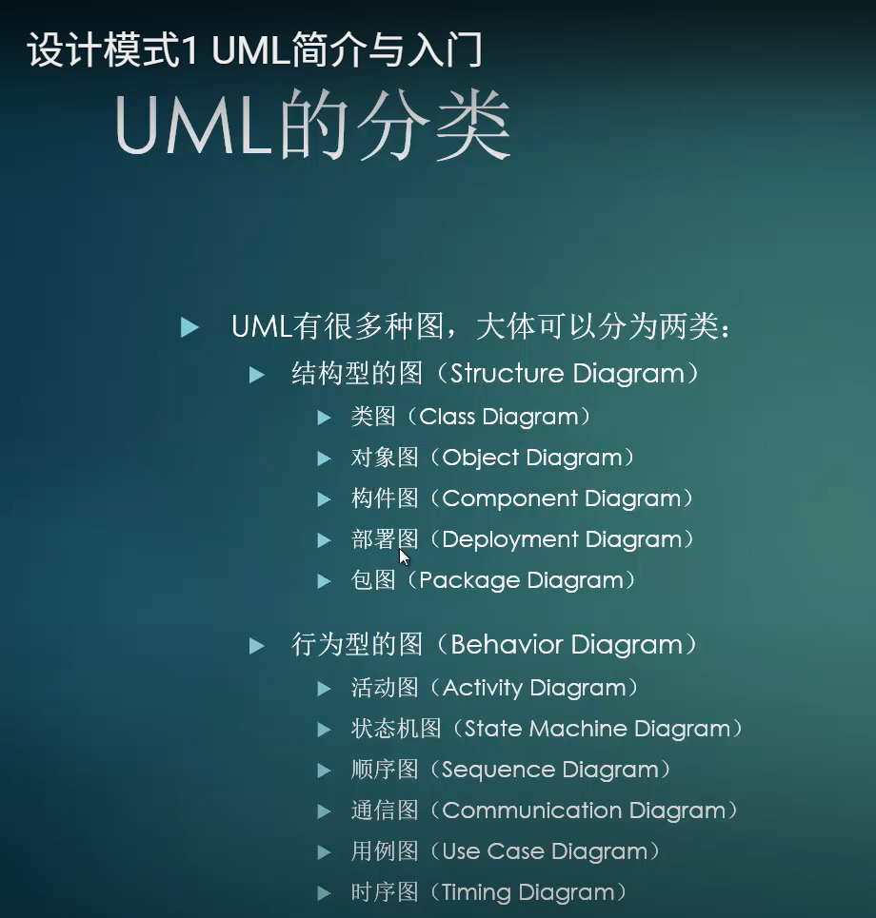


Slide 64
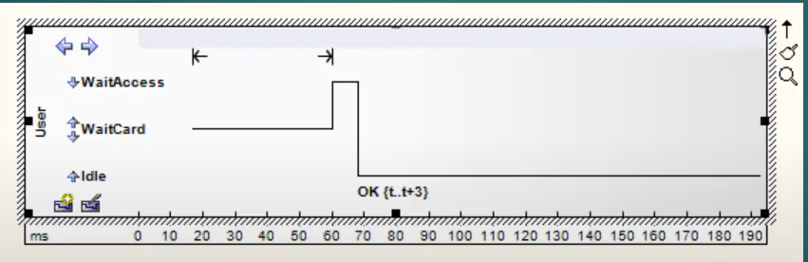
Timing Diagram

Slide 65
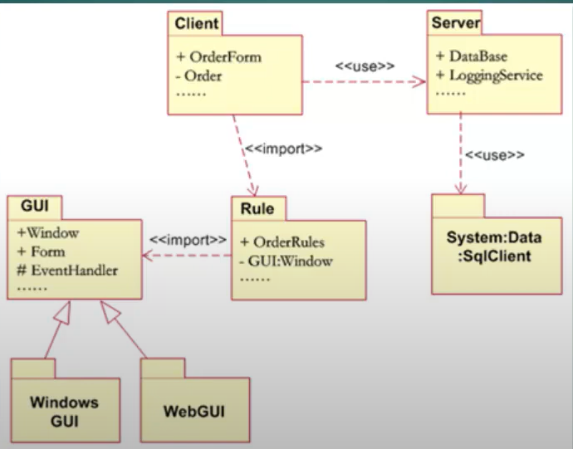
Package Diagram

Slide 66
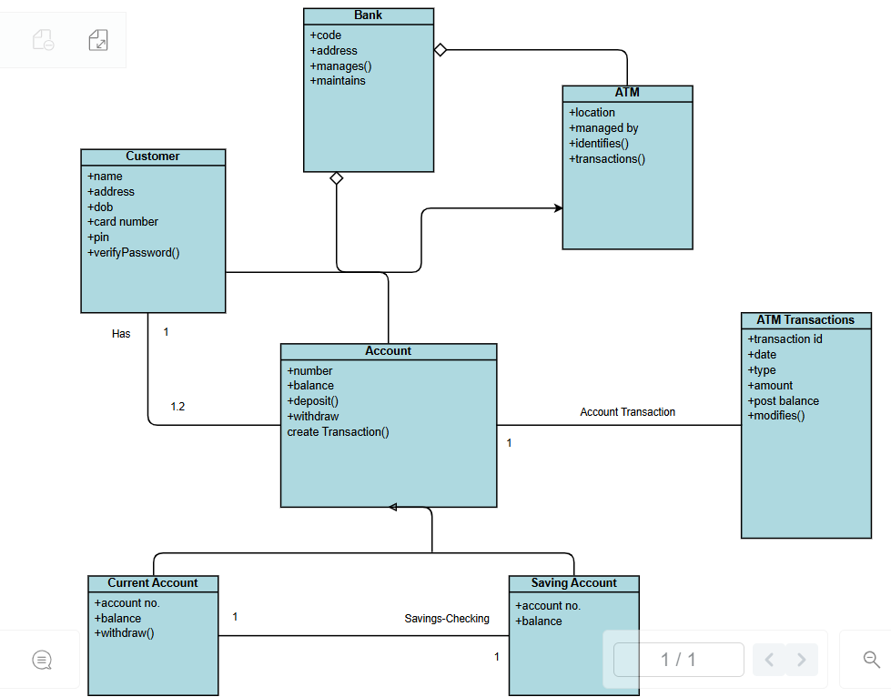
Class Diagram

Slide 67
Class name (Person)
Interface name (computerInterface)
id: String
name: String
Age: int
boolean verifyId(String id);
String fetchAddress(String id);
computerInterface
boolean verifyId(String id);
String fetchAddress(String id);
+ public
- private
# protected
~ package
_ static
abstract

Slide 68
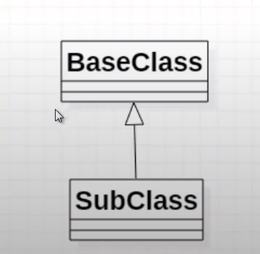
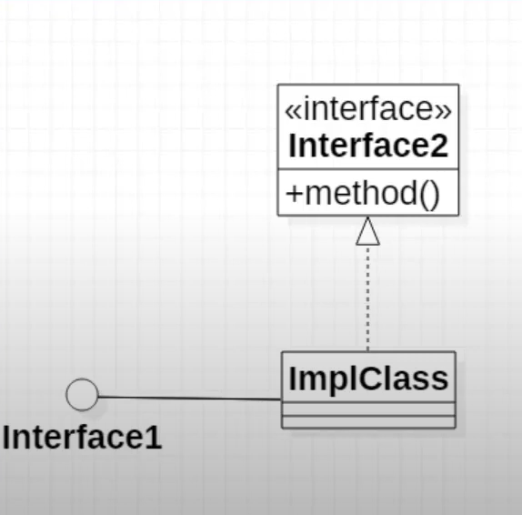
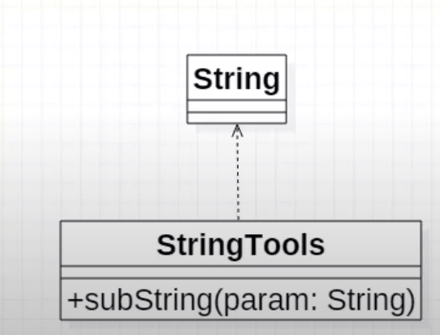
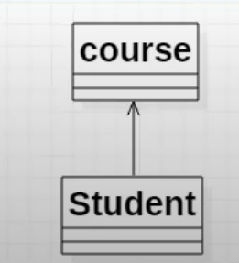
Generalization (extends)
Realization (implements)
Dependency (import)
Association
class Student {
List<Course> courses = new ArrayList<>():
…
=

Slide 69
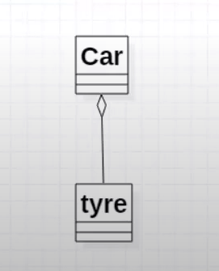
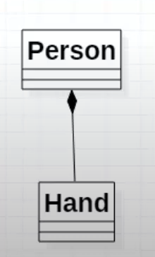
Aggregation
Composition
class Person {
private class Hand {
…
}
Hand left = new Hand();
Hand right = new Hand();
…
}
class Car {
Tyre frontLeft = new Tyre();
Tyre frontRight = new Tyre();
Tyre backLeft = new Tyre();
Tyre backRight = new Tyre();
Typre backup = null;
…

Slide 70
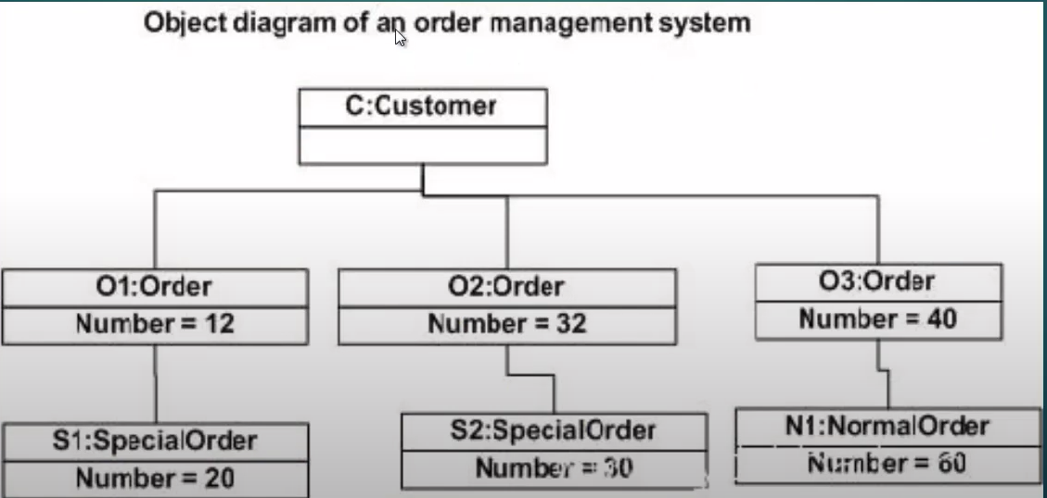
Object diagram

Slide 71
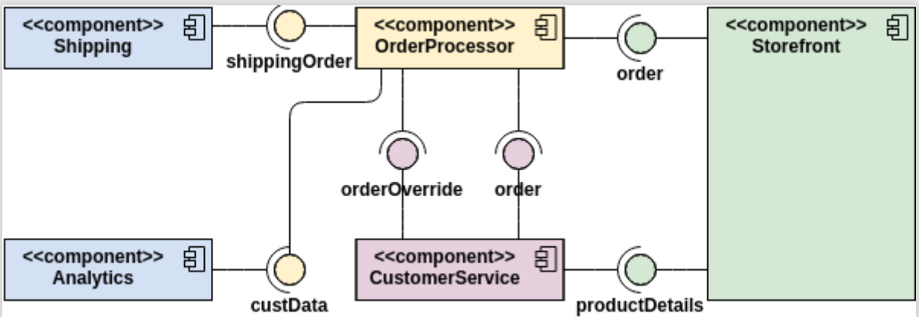
Component Diagram

Slide 72
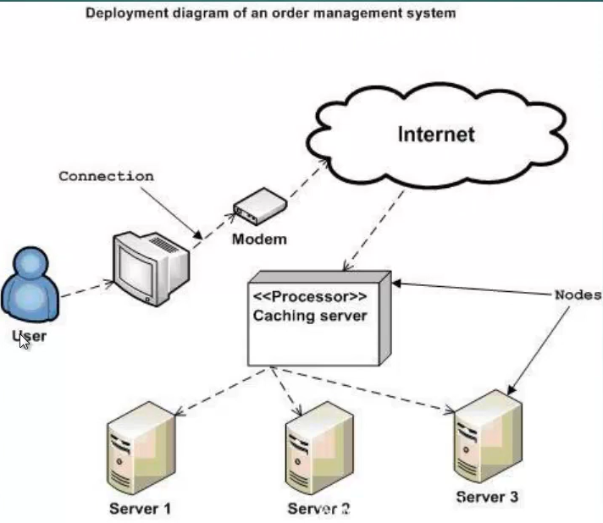
Deployment Diagram

Slide 73
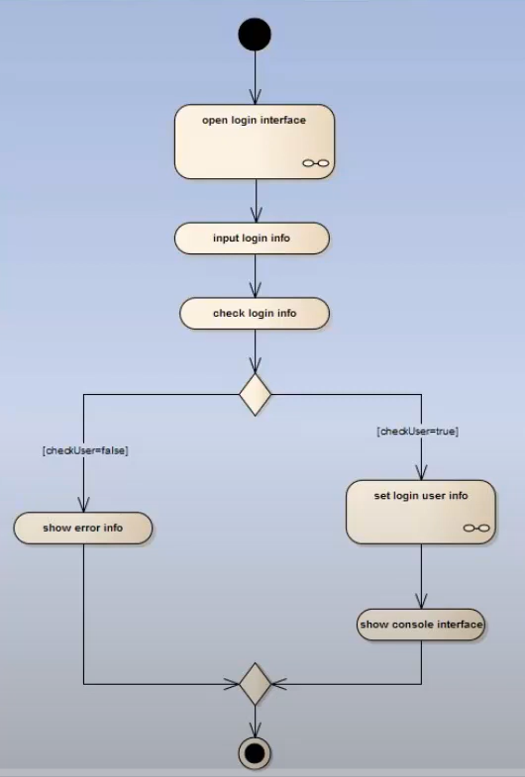
Activity Diagram

Slide 74
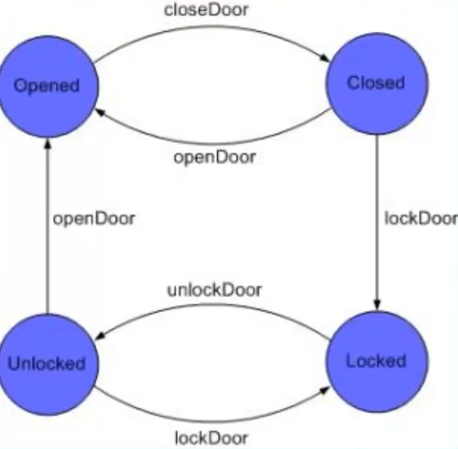
State Machine Diagram

Slide 75
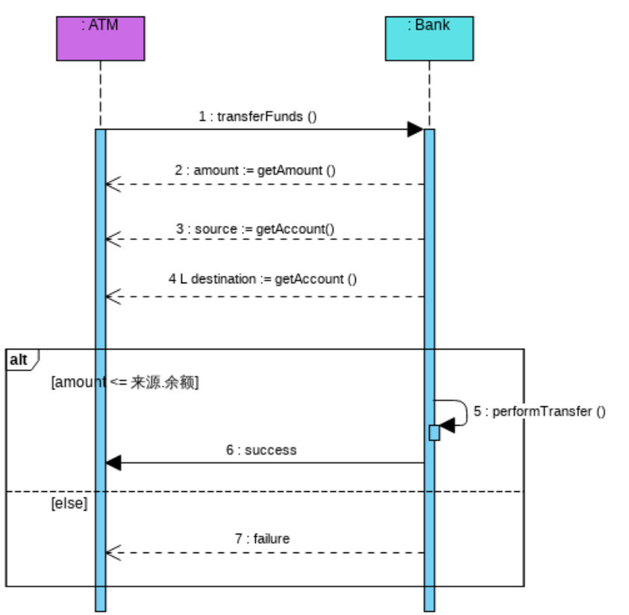
Sequence Diagram
balance

Slide 76
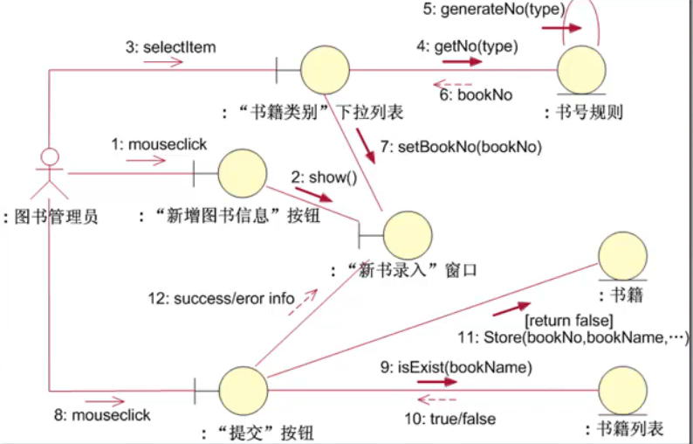
Communication Diagram
Dropdown list “book type”
Book no rule
Library Admin
button “new book”
window “info input”
Database: books
button “submit”
Database: book names

Slide 77
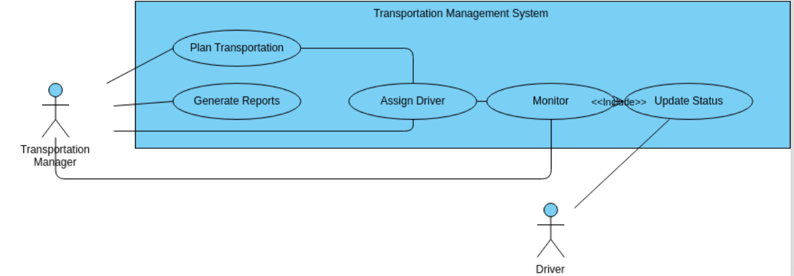
Use Case Diagram

Slide 78
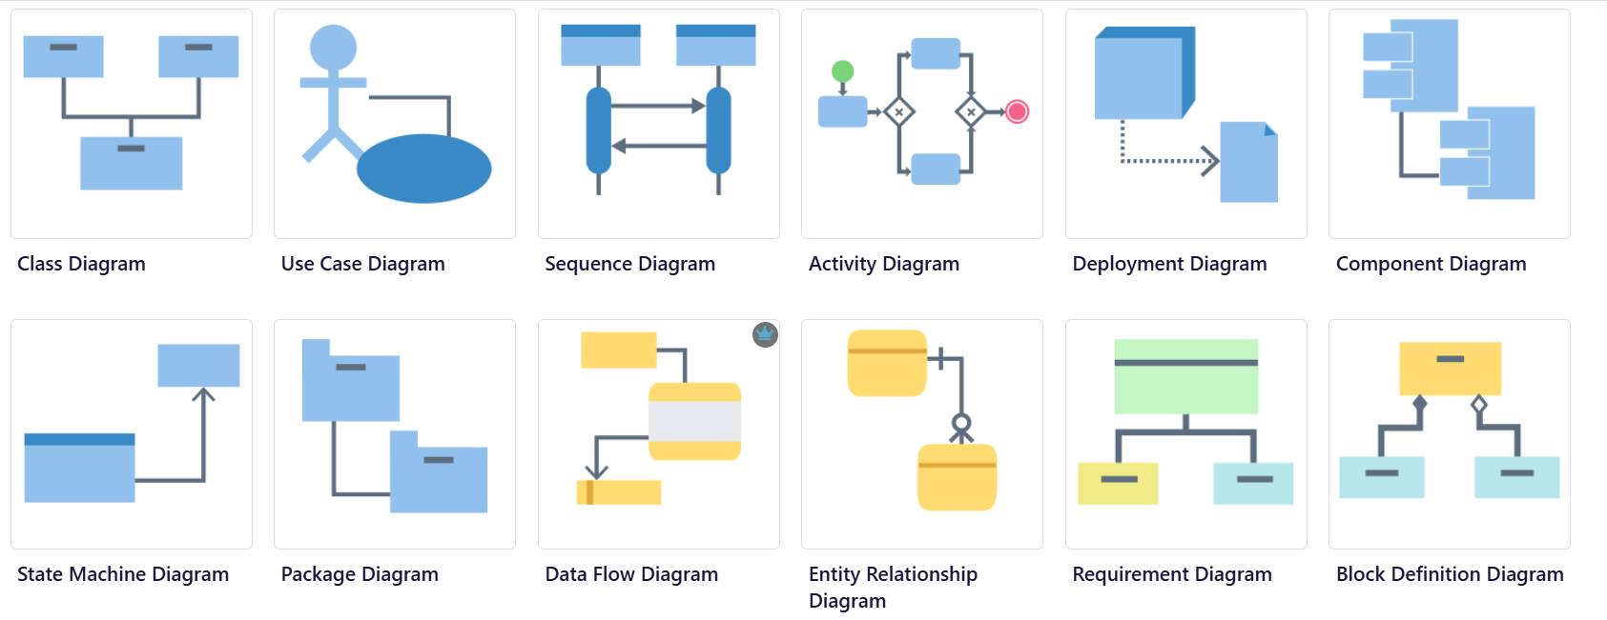

Slide 79
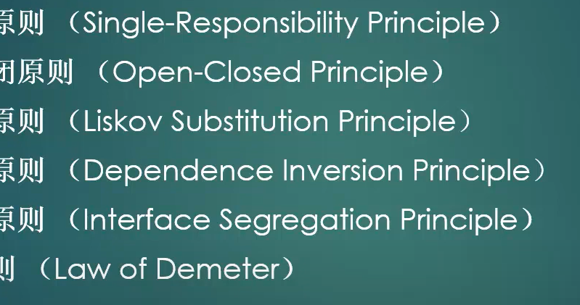
OOD Principles

Slide 80
Recorder: Customer
firstName
lastName
Address
phoneNumber
email
Recorder: Customer
firstName
lastName
Address
phoneNumber
email
class: CustomerMain
+ main(): f, l, a, p, e
class: CustomerMain
+ main(): f, l, a, p, e -> Customer
class: CustomerPrinting
class: CustomerPrinting
+ printCustomer(f, l, a, p, e -> Customer)
- printDetail(Customer)
+ printDetail(Customer)

Slide 81

class: DrawingMain
class: Drawing
class: DrawingMain
class: Drawing
+ main(): Drawing, Circle, Rectangle, Ellipse
+ drawShape(Circle)
+ drawShape(Rectangle)
+ drawShape(Ellipse)
+ main(): Drawing, Circle, Rectangle, Ellipse
+ drawShape(Shape)
class: Shape
class: Circle
class: Rectangle
class: Ellipse
+ draw
+ draw
+ draw
+ draw
class: Circle
class: Rectangle
class: Ellipse

Slide 82
Liskov Substitution Principle

Slide 83
class: MatrixMain
class: MatrixConfig
class: MatrixMain
interface: Configable
+ main(args)
- printMatrix(e, w, h)
+ getConfig(key);
+ main(args)
- printMatrix(e, w, h)
+ getConfig(key);
class: MatrixProperty
class: MatrixConfig
class: MatrixProperty

Slide 84
class: PcMain
class: Power
class: PcMain
class: Power
+ main(args)
+ buildPc()
class: Motherboard
+ main(args)
+ buildPc()
class: Motherboard
class: CPU
class: CPU
class: Memory
class: Memory
class: Harddisk
class: Harddisk
class: keyboard
class: Hardware
class: keyboard
class: Mouse
class: Mouse
class: Peripheral
class: Os
class: Os
class: Editor
class: Editor
class: Player
class: Software
class: Player
class: WebBrowser
class: WebBrowser

Slide 85

class: EquipmentMain
interface: Equipment
class: EquipmentMain
interface: Electrifable
+ main(args)
+ powerOn
+ powerOff
+ display(): String
+ getOsInfo(): String
+ getPrice(): float
+ main(args)
+ powerOn
+ powerOff
+ getPrice(): float
interface: Displayable
interface: Osable
+ display(): String
+ getOsInfo(): String
+ getOsVersion(): String
class: lamp
class: lamp
class: TV
+ display(): String
+ getOsInfo(): String
class: TV

Slide 86
func* setup:
func* loop;
void register(func* my_setup, func* my_loop) {
setup = my_setup;
loop = my_loop;
}
void main(args) {
register(args)
…
setup();
…
for (;;) {
loop();
….
}
]
void setup() {
…
}
void loop() {
…
}

Slide 87
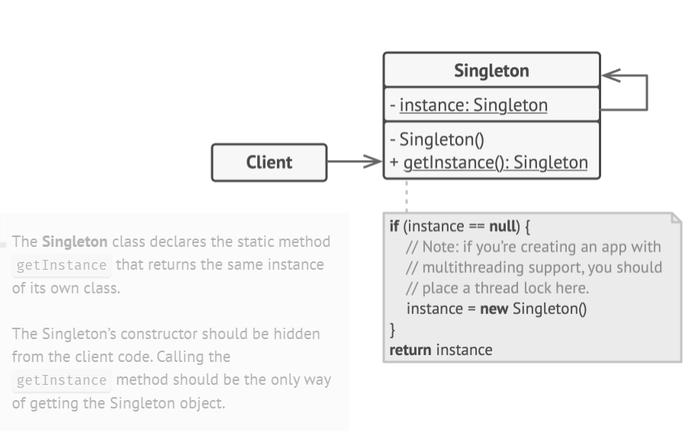
Design Patterns - Singleton
https://refactoring.guru/design-patterns/java

Slide 88
Object thread1
class: Singleton
+ getInstance()
- singleton
+ getInstance()
new Singleton
Object thread1
+ getInstance()

Slide 89
CV
Locker
C (0..1)
Singleton resource
unlocker
V (0..1)
Atomic
1, Read CV (CV>0)
2, Reduce CV
3, Do something
Thread4
Locker
C (0..3)
limited resources
unlocker
V (0..3)
Thread1
limited resources
Thread2
limited resources
Thread3

Slide 90
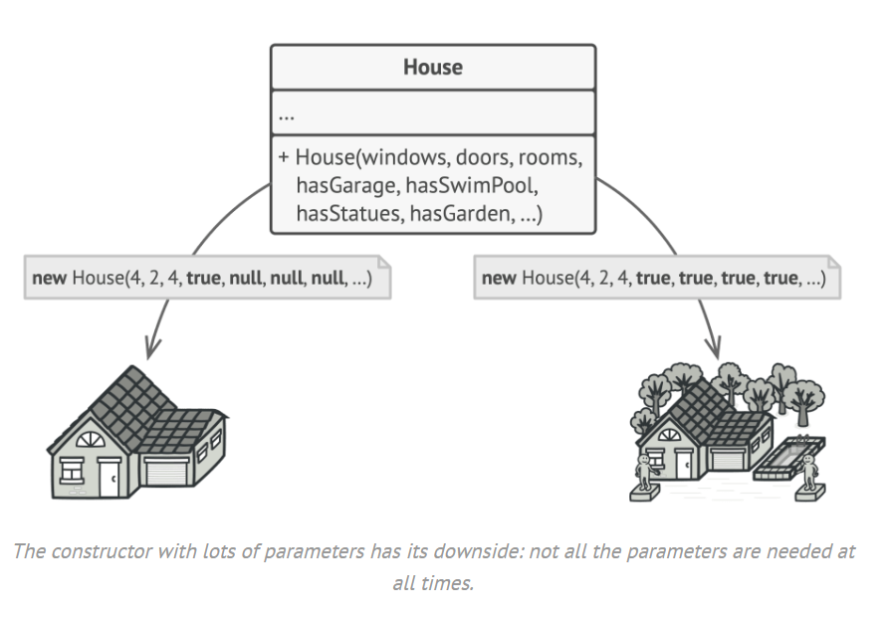
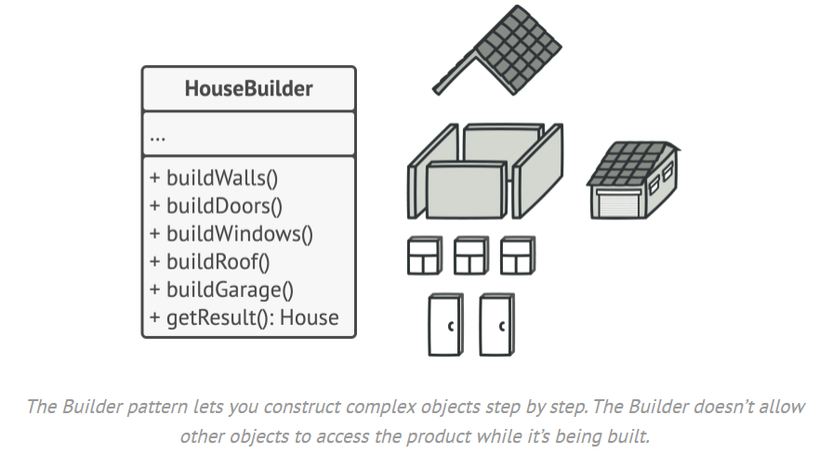
Design Patterns - Builder

Slide 91
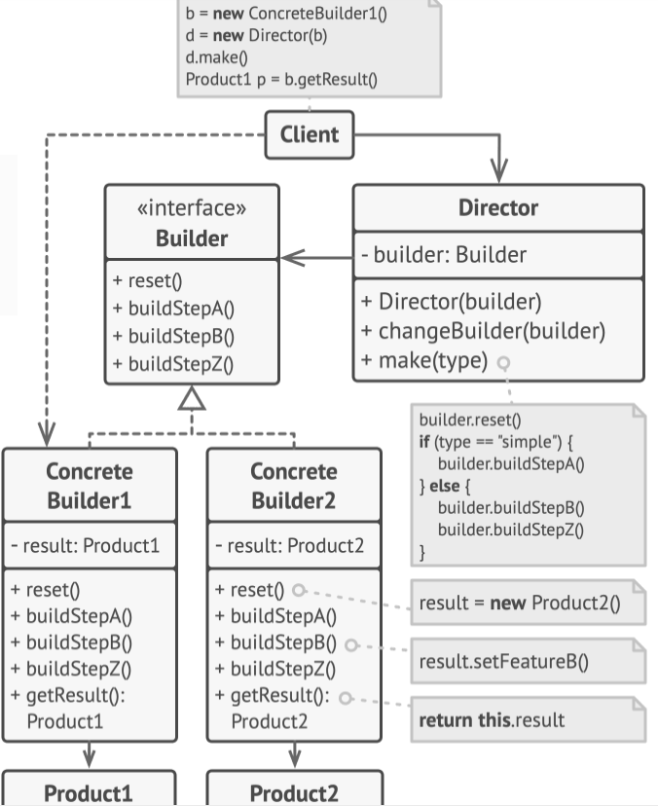

Slide 92




Design Patterns - Builder
interface: Vehicle<T>
setVehicleType()
SetSeats()
setEngine()
setTransmission()
T build()
class VehicleDirector
+ buildVehicle(String)
class: CarBuilder
class: TrunkBuilder
setVehicleType()
SetSeats()
setEngine()
setTransmission()
build()
setVehicleType()
SetSeats()
setEngine()
setTransmission()
build()
class: Car
class: Trunk
+ Car(Type, Engine, seats, transmission)
+ Car(Type, Engine, seats)

Slide 93



Design Patterns - Factory
class: Driver
+ getDestination()
+ planTrip
+ selectRoadVehicle(String): RoadVehile
+ drive(RoadVehicle)
RoadVehicle.driveoOnRoadl()
+ deliver(Parcel)
class: RoadVehicleFactory
+ create(String): RoadVehicle
interface: RoadVehicle
+ driveOnWheel()
class: Car
class: Truck
+ driveOnRoad()
+ driveOnRoad()

Slide 94
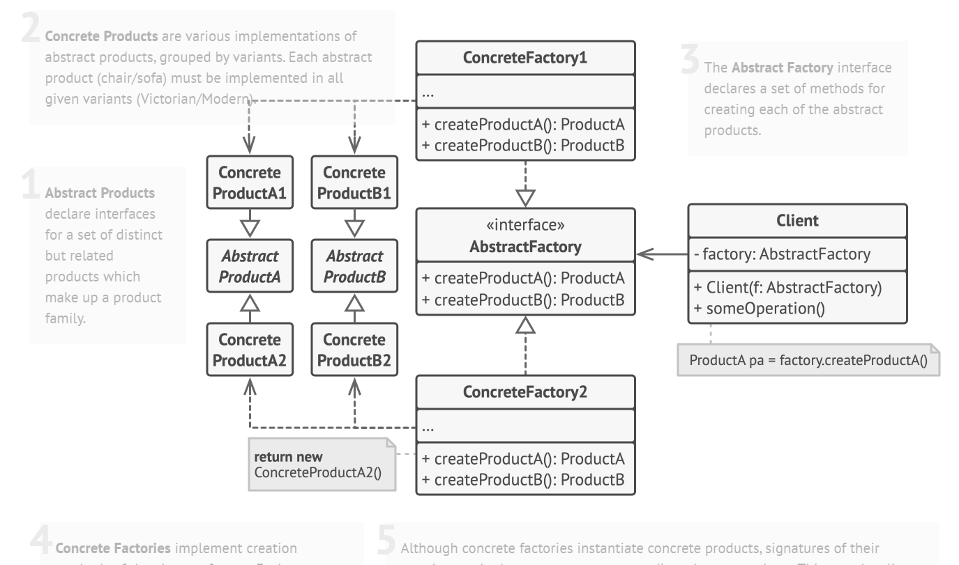
Design Patterns - Abstract Factory

Slide 95




class: MacOsFactory
+ createButton()
+ createCheck()
interface: Button
+ paint()
interface: Check
+ paint()
interface: GUIFactory
+ createButton()
+ createCheck()
class: MacOsButton
class: MacOsCheck
+ paint()
+ paint()
class: WindowsButton
class: WindowsCheck
+ paint()
+ paint()
class: WindowsFactory
+ createButton()
+ createCheck()

Slide 96
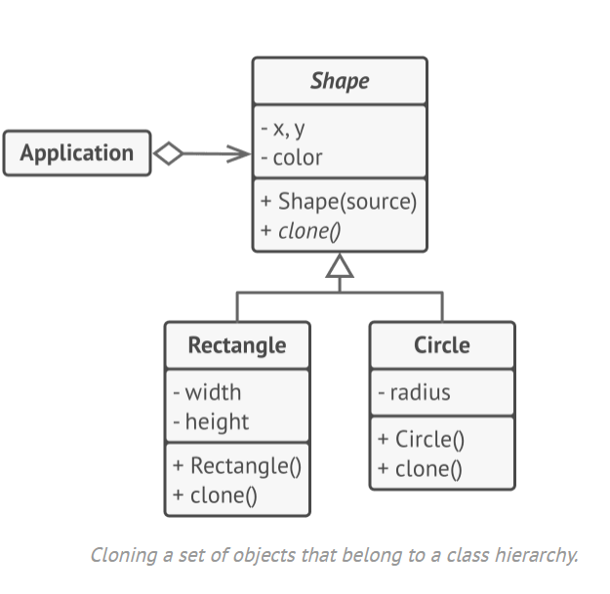
Prototype

Slide 97
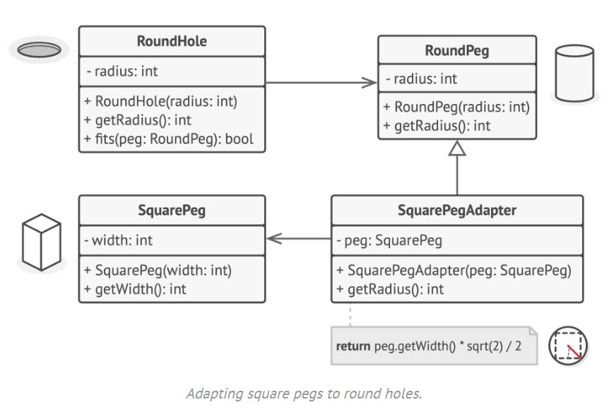
Design Patterns - Adapter

Slide 98
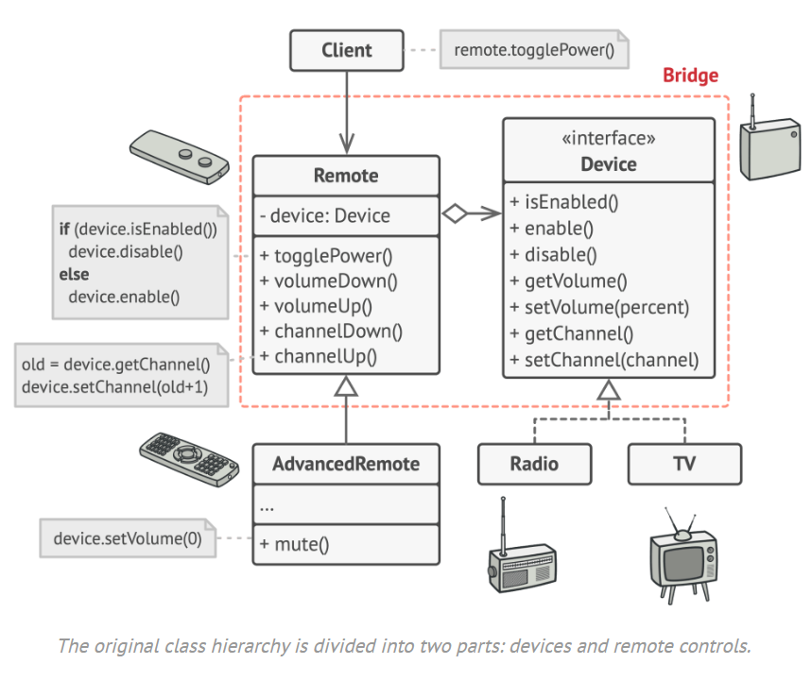
Design Patterns - Bridge

Slide 99
Design Patterns - Bridge
+ power()
+ volumeDown()
+ volumeUp()
+ channelDown()
+ channelUp()

Slide 100
Design Patterns - Bridge
interface: BasicRemote
+ power()
+ volumeDown()
+ volumeUp()
+ channelDown()
+ channelUp()
class: DeviceMain
class: Remote

Slide 101
Design Patterns - Bridge
interface: BasicRemote
+ power()
+ volumeDown()
+ volumeUp()
+ channelDown()
+ channelUp()
class: DeviceMain
class: Remote
interface: AdvancedRemote
+ mute()

Slide 102
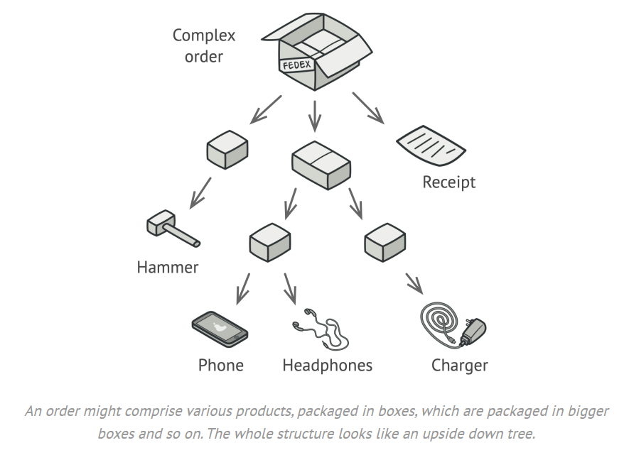
Design Patterns - Composite
interface: Component
+ display()
class: Product
class: Box
+ display()
+ display()
+ add(Component)
+ remove(Component)

Slide 103
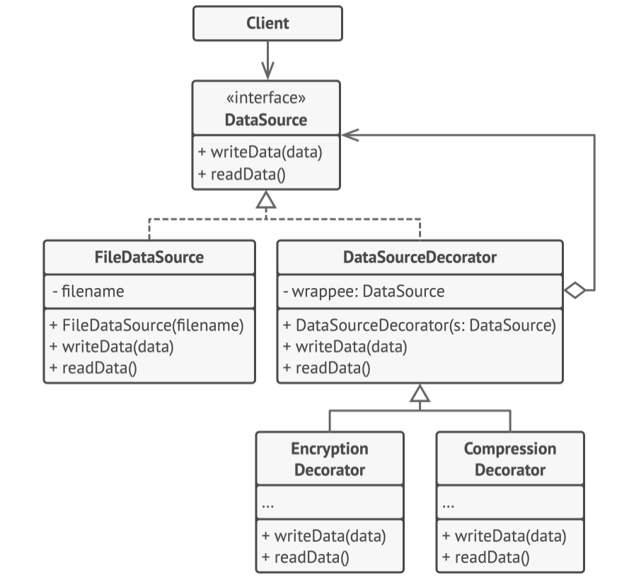
Design Patterns - Decorator

Slide 104
CODEC
Nyquist–Shannon sampling theorem - Wikipedia
Analog
Sampling
Binarization
10101100….
64K Hz
Compress / encryption
CODEC:
Audio: G.711 a / G.711 u / AMR / AMR2 / MP3
Video: MPEG4 (MP4) / ogg
10101100….

Slide 105
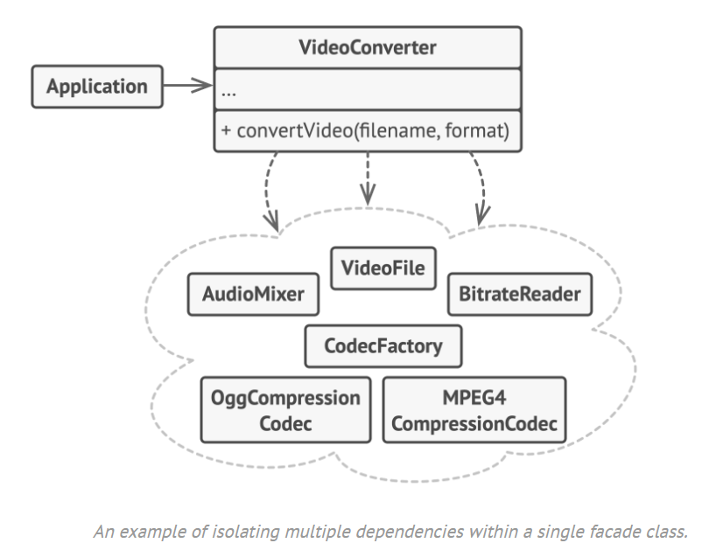
Design Patterns - Facade

Slide 106
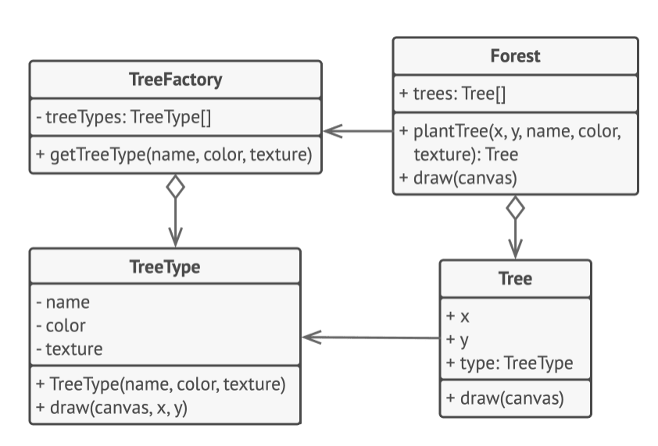
Design Patterns - Flyweight

Slide 107
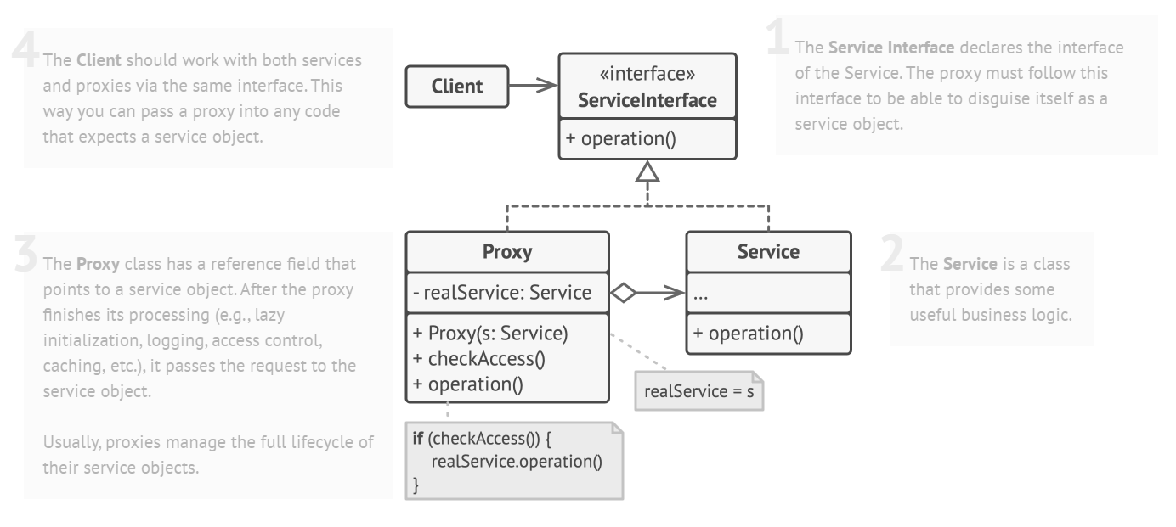
Design Patterns - Proxy

Slide 108
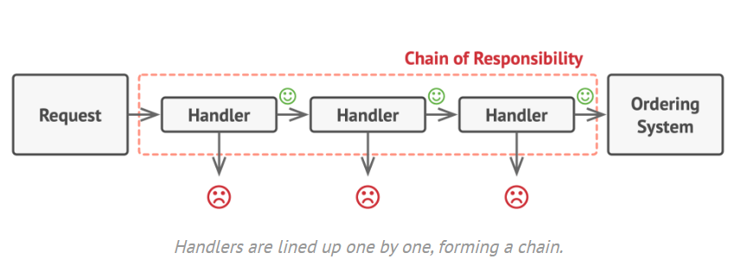
Design Patterns - Chain

Slide 109

Design Patterns - Command
class: Button
class: Shortcuts
class: CopyCommand
class: PasteCommand
class: Editor
 | Copy | Cut | Paste | Undo
Button
Shortcut

Slide 110


Slide 111
class: RemoteController
+ turnOn
+ turnoff
+ adjustVolume
+ changeChannel
class: TV
+ turnOn
+ turnoff
+ adjustVolumen
+ changeChannel
class: mobile
+ turnOn
+ turnoff
+ adjustVolume
+ changeChannel
class: stereo
+ turnOn
+ turnoff

Slide 112
class: TurnOnCommand
+ execution()
class: RemoteController
+ turnOn
+ turnOff
class: TV
class: TurnOffCommand
+ execution()
class: stereo
class: MobileController
+ turnOn
+ turnOff
class: AdjustVolumeCommand
+ execution()
class: ChangeChannelCommand
+ execution()

Slide 113
Design Patterns - Iteratorc
class: IteratorMain
interface: ChannelIterator
interface: ChannelCollection
+ next()
+ hasNext()
+ reset()
+ add(Channel)
+ getChannels()
+ getIterator(): ChannelIterator
class: ChannelIteratorImpl
class: ChannelCollectionImpl
- index (cursor)
+ add(Channel)
+ getChannels()
+ getIterator(): ChannelIterator
+ next()
+ hasNext()
+ reset()

Slide 114

Design Patterns - Mediator

Slide 115
Airplane
Airplane
ControllTower
Airplane
Airplane

Slide 116


Design Patterns - Memento
class: MementoMain (user)
class: History (caretaker)
undo
- List<Memento>
+ pushMemento(Memento)
+ popMemento(): Memento
Edit / write / …
class: DocumentMemento (snapshot)
+ Memento constructor(snapshot)
+ Memento.getSavedContent();
class: Document (Originator)
+ write(String)
+ getContent():String
+ createMemento() <- snapshot
Memento constructor(snapshot)
+ restoreFromMemento()
Memento.getSavedContent();
interface: Memento (snapshot)
+ getSavedContent() <- getSnapshot

Slide 117
















Fiber / copper
Network cable
ISP network
Internet
IMSI (SIM card)
International Mobile Subscriber Identity
Radio Access Network (RAN)
Radio Node Controller (RNC)
HSS (Home Subscriber Server)
Base station (node B)
PLMN (Public Land Mobile Network)
Operator Core Network
Telia , Tele2, comviq, 3, …

Slide 118

Internet Service Provider (ISP)
Telia, stockholmsstadsnat

